Slide 1
Open Sourcing From Within Your Company, For Your Company
MIL-OSS, Thursday, May 24^{h} 2012
by Bob Williams
Notes:
Thank you for having me
I’m really glad and honored to be here
What a great event this is…how about a quick round of applause once again for mil-oss☺

Slide 2
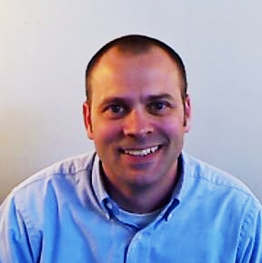
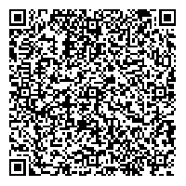
About Me
Bob Williams
CTO / Analytics Evangelist
bob.williams@sparcedge.com
Twitter
@_bobwilliams
Come see Innovation, Culture
and Open Source in Action
tours@sparcedge.com - tours held daily.
www.sparcedge.com
Notes:
I am responsible for leadership, technology vision and direction
I am very active on Twitter. You can find me @_bobwilliams
And I am very passionate about
open communication,
innovation through collaboration and
free exchange of ideas
Which is great because

Slide 3
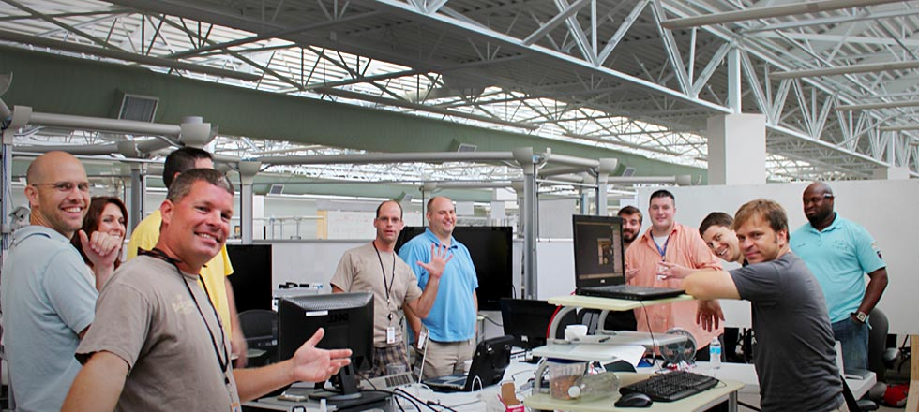
Who is SPARC!
Software Product Development and Integration
2011 Best Place to Work in SC
165+ employees / 500% Growth in 2011
Service Disabled Veteran Owned Small Business
Notes:
The company I work for fully embraces my passions
At SPARC we believe we engage people through better information
We have a really good work environment
Decent size shop and we’ve grown a lot
And oh yea…we write software ☺
Whether it be for Enterprise, Cloud, Web, Mobile, Cyber, Analytics, Culture, Engagement, Green Energy

Slide 4
Open Source Your Entire Organization
Open Source Everything Possible!
Notes:
Here to challenge you to open source everything, everything possible, everything you can
Not just use open source software or contribute to it
But to open source your departments, your processes, the things you might have considered company secrets before
Open source your entire organization…change your mindset
Open source can be and is about more than just software…take it on as a way of life
And I’ll define open source as sharing something of value and accepting feedback & contributions
Letting its value grow through the collaboration and use of others
And if you do I’ll promise you a more
Engaged, excited and innovate workforce
You’ll better understand your business and processes
Your competitors will become your collaborators
And It’s all basically for free
Not sure how to even start
5 easy steps

Slide 5
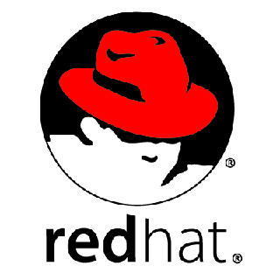



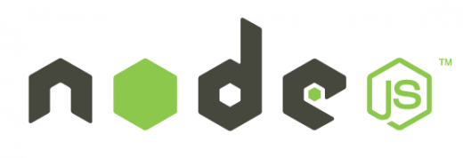
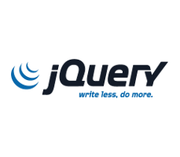

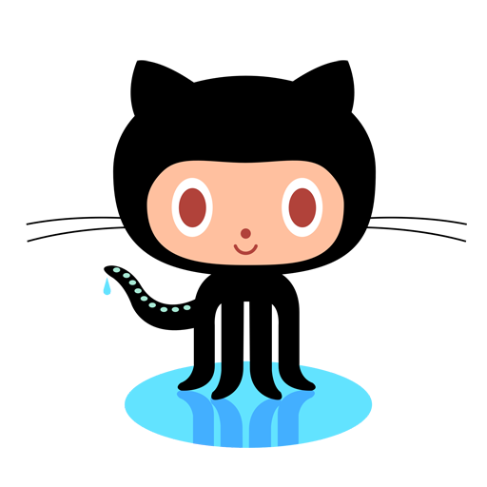


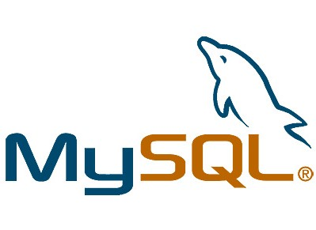


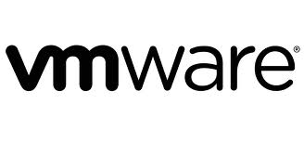
Step One – Use
Find open source software that you can use in your projects.
Get used to it and the open source model.
Take that first step to using it!
Notes:
So, step one is to use open source
Allow it, get used it, learn about it
Find projects you have today that can leverage open source software
Maybe that’s a lower risk project to use as your comfort builds
Maybe that’s an internal or R&D effort
But bring open source software inside your walls so you can understand the model and take that first step.
We use open source

Slide 6
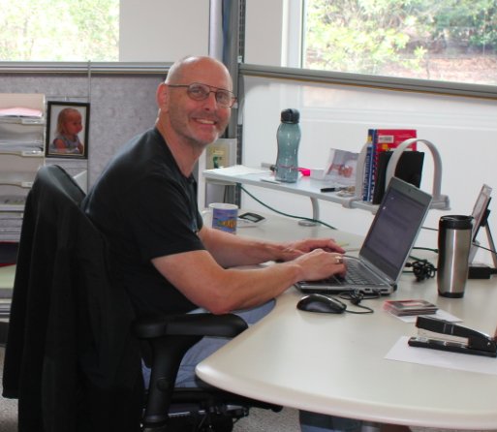
Step Two – Contribute
Give back to the community and uphold your end of the open source agreement.
Learn the “share/make it better” part of open source.
Take that next step!
Notes:
contribute back to the projects you are using
often overlooked piece
Community
Learn the benefits by seeing them work for someone else
Share/make it better
Dev download open source and not contribute
Take that next step!

Slide 7
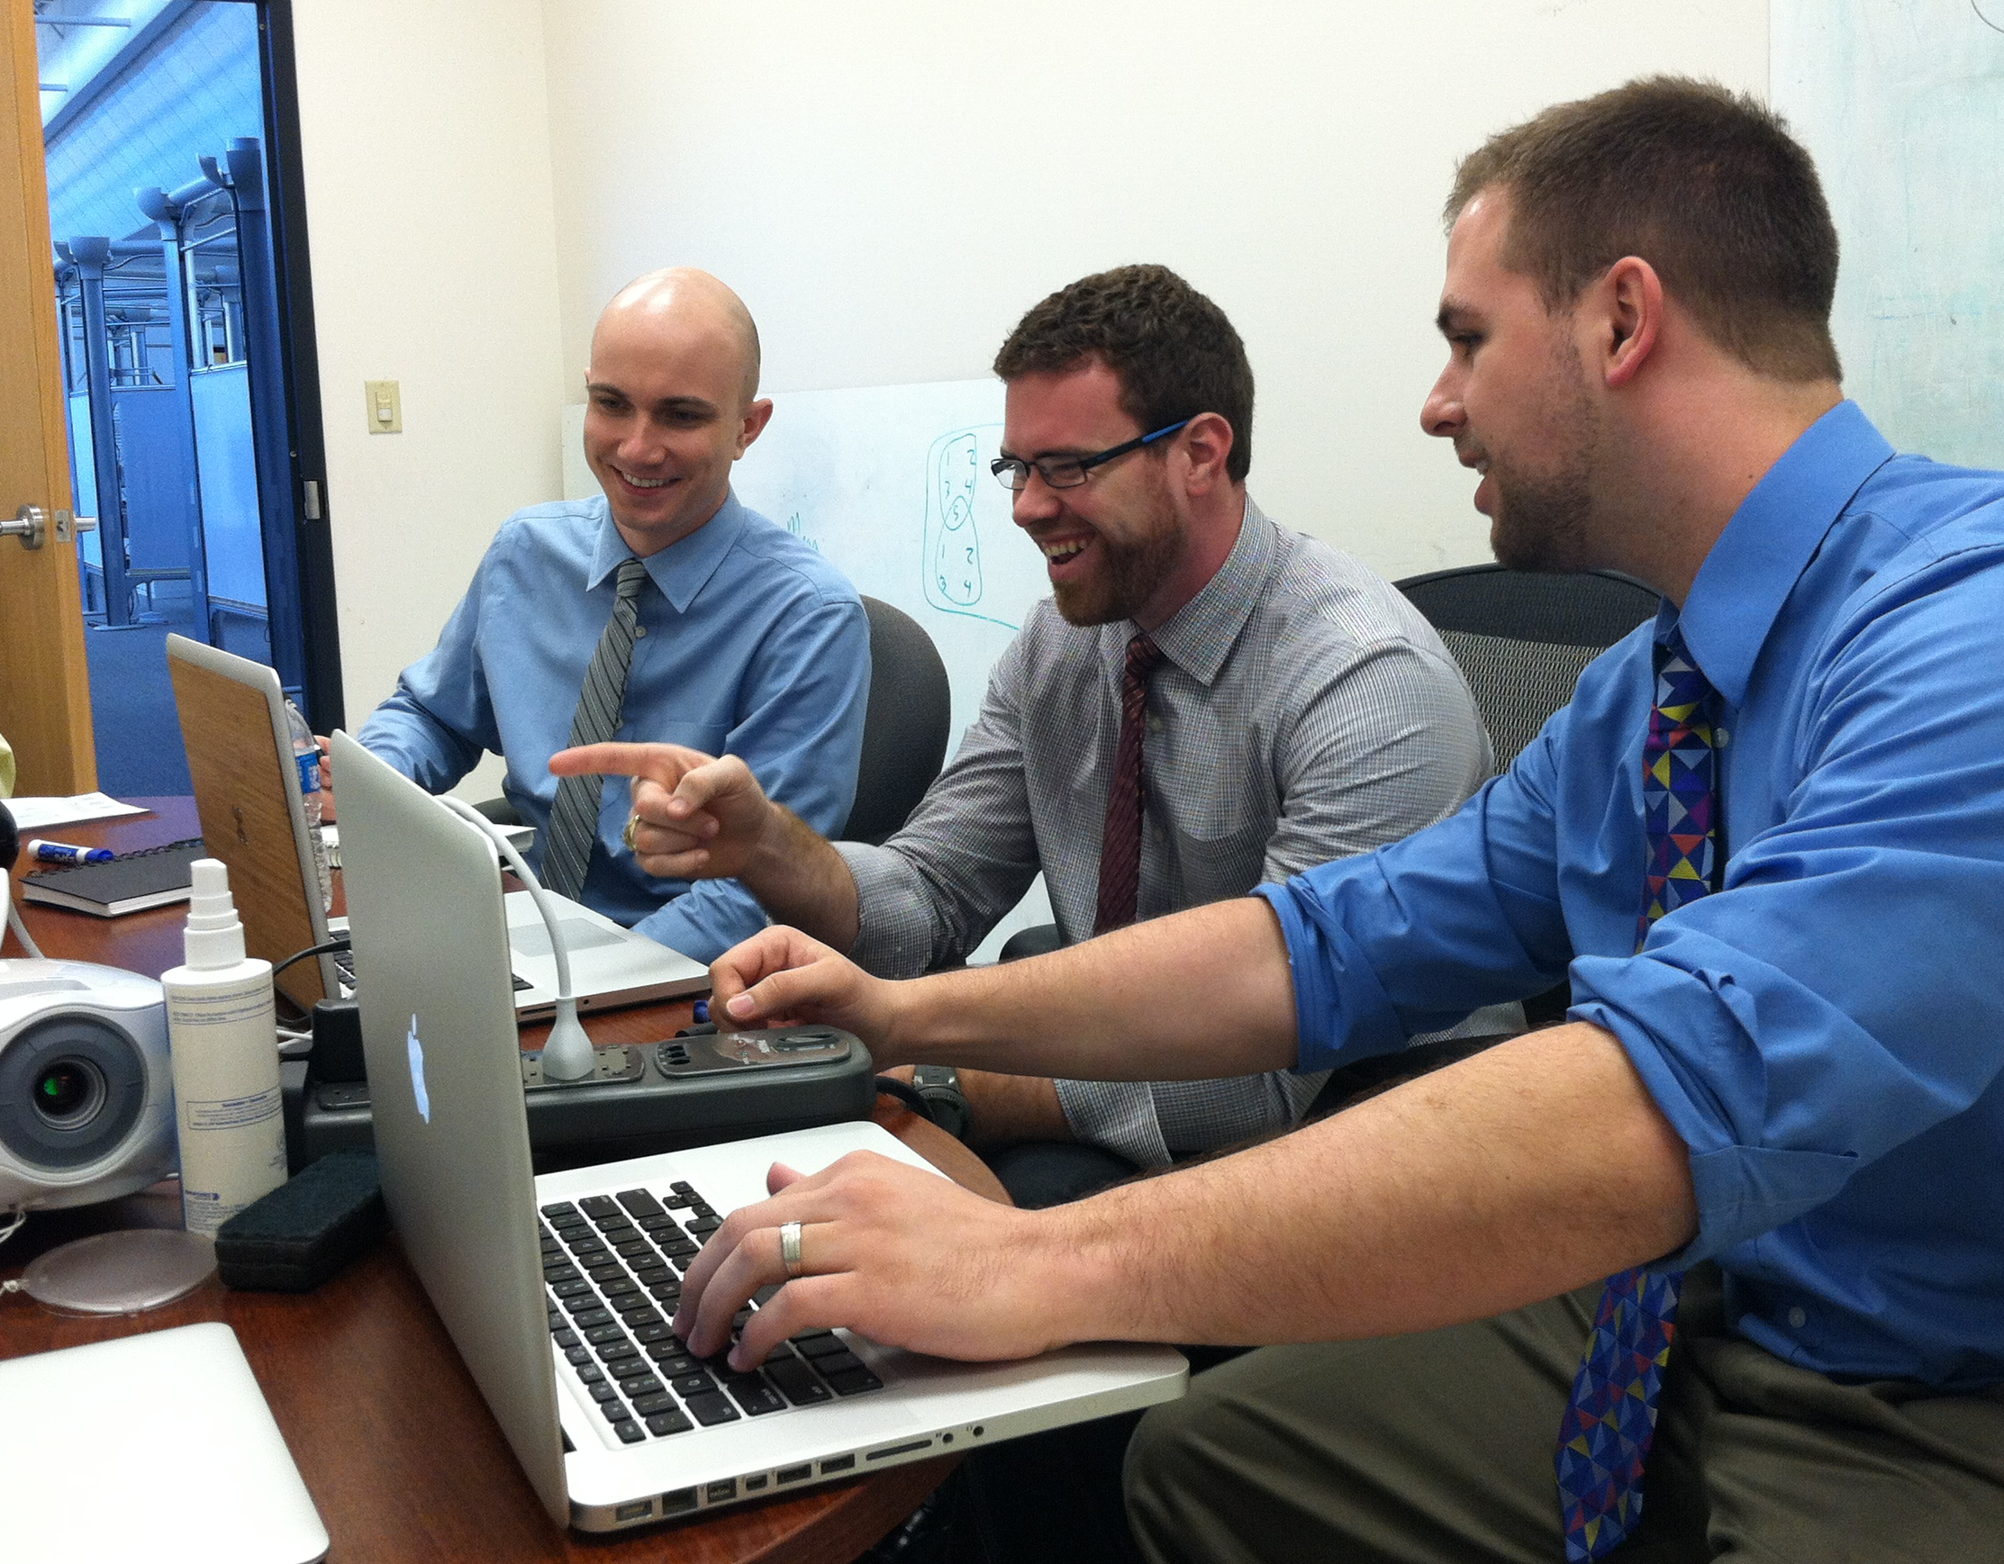
Step Three – In-House
Learn how to open source your own project(s).
Allow them to work together across teams and build better collaboration.
Create excitement and additional energy!
Notes:
in-house open source solution.
Open source your own project from the ground up
Use github, bitbucket or similar
Create the support for your engineers to contribute to each others projects
Set boundaries

Slide 8
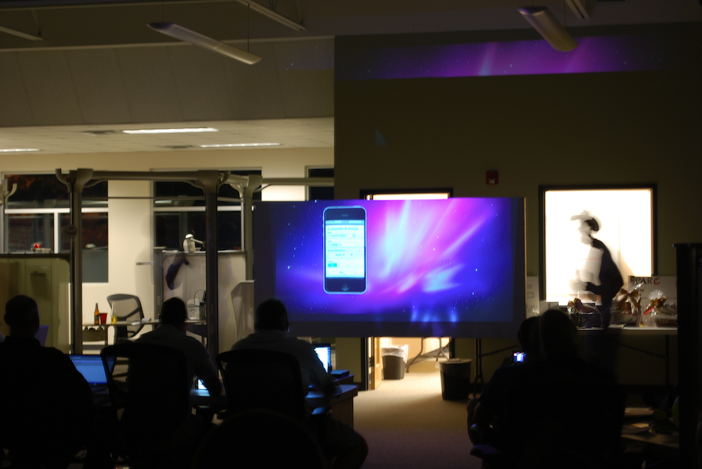
Step Four – Review
Developers like clout and like to be heard.
Let them show-off to their peers, managers and the company as a whole.
Give them bragging rights!
Notes:
I’m speaking to the IT leaders, managers, executives
Build the platform for cultural acceptance
Peers, leadership, executives, company
clout and bragging rights
Waterfall vs agile

Slide 9

Step Five – Expand
Now that you have embraced open source, don’t stop.
In what other areas of your company could you apply the open source model?
Find ways to capitalize on the advantages of the open source model throughout your entire organization!
Notes:
Might seem the hardest but it’s the easiest step
You now understand open source
Have learned a lot
Don’t stop now
Take it to that next level

Slide 10
Why?
So Why Does
SPARC
Open Source?
Notes:
Before I go any further let me take a moment to
Make it personal and tell you why SPARC open sources
At SPARC we do not believe in holding something of value tightly and closely to our chest.
For us, especially with the growth we see and agility we move with it requires too much effort and energy to take that tightly held value and retain its value or make it more valuable
In fact, we believe the full value can only be achieved by sharing and letting others help us make it more valuable
We have seen the rewards of the promises I made earlier of a more
Engaged, excited and innovative workforce
Understanding our business and processes better
Of our competitors and even companies in other markets become our collaborators
We do not open source everything…yet
But we are open sourcing more and more every day
And we are only seeing positive results and success from it
We have no reason not to open source
You maybe saying to yourself, I get the steps and why you do it, but I’m not sure of what I can actually do
Let me give you some examples

Slide 11
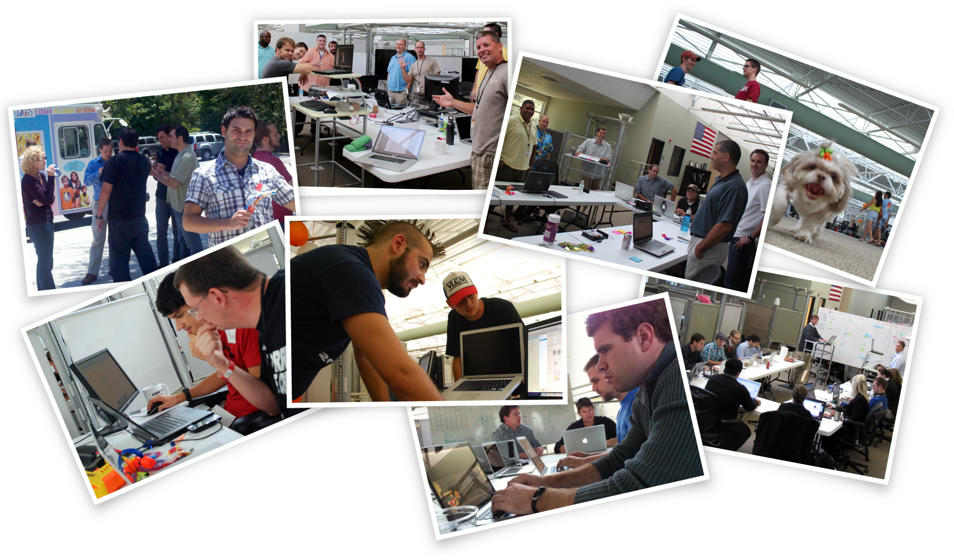
SPARC and Open Source
Notes:
Hackathons
Describe the event
Open to any and everyone
Code is open sourced
Volunteers have made it better
HR
We give it away
70 companies have seen it
Some of those actively contribute
Even SPARC Team Members contribute
SPARC U (it time allows)
Open to the public
User Groups
GitHub, VMWare, Health and Wellness, Employee Recognition
Team Member generated content: Java Certifications, Mobile Development, Presentation Zen, IA & Security
Feedback, surveys – how do we make it better

Slide 12


Slide 13

SPARC IQ
SPARC’s Real-Time, BigData Analytics Platform
Pure Open Source Stack
Backbone for SPARC’s Products
Think lot’s of data coming in fast
Think deep number crunching for insight
Notes:
Re-iterate slide bullets

Slide 14






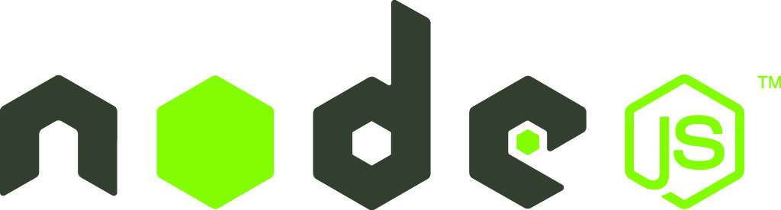


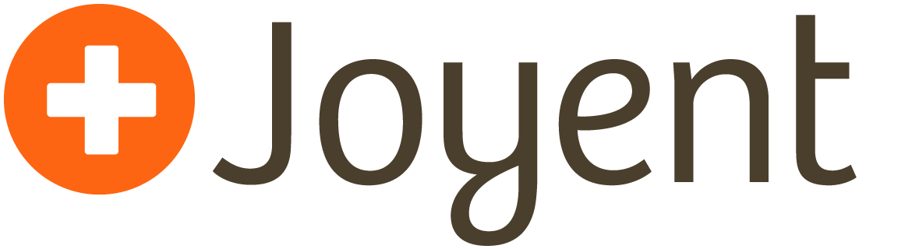

SPARC IQ
Scala
and more…
connect
node-hashring
node-http-signature
Notes:
We use a lot of open source projects
A few not listed here

Slide 15

SPARC IQ
connect
node-http-signature
node-hashring
Notes:
As in step 2 Contribute we give back to the community
Having contributed to the projects you see here

Slide 16
SPARC IQ
We Open Source our Own Stuff Too!
hook.io-ring
Hook.io hooks for creating ridiculously simple, self-forming consistent hashing rings.
hook.io-ring-http-server
Hook.io hook for easy distribution off http servers, with client-server orchestration.
cb
A minimal node.js utility for handling common (but often overlooked) callback scenarios.
jquery.jade.js
A lightweight jQuery plugin providing a friendly API for using the jade template engine.
connect-http-signature
Connect middleware wrapper for Joyent's HTTP Signature reference implementation.
More projects coming soon!
Notes:
We also have open sourced projects of our own
From messaging frameworks
To asynchronous callbacks routines
To even jQuery plugins
Many there will be more coming as they are ready

Slide 17
SPARC Knappsak!
Notes:
Excited to mention our mobile application distribution product
Which we are open sourcing the entire product

Slide 18
Knappsak: Mobile App Distribution
Open source solution providing organizations a secure method of managing and distributing applications.
Support for iOS, Android, Blackberry and all popular browsers.
Install applications directly from a mobile browser or desktop.
Notes:
Tell what it is
secure way for a company to distribute mobile applications to its users
supports your major mobile platforms and browsers
allows companies to administer and manage their applications
Why: we had an internal need that we built via the in-house step basically
and in our review steps decided to contribute the entire product

Slide 19
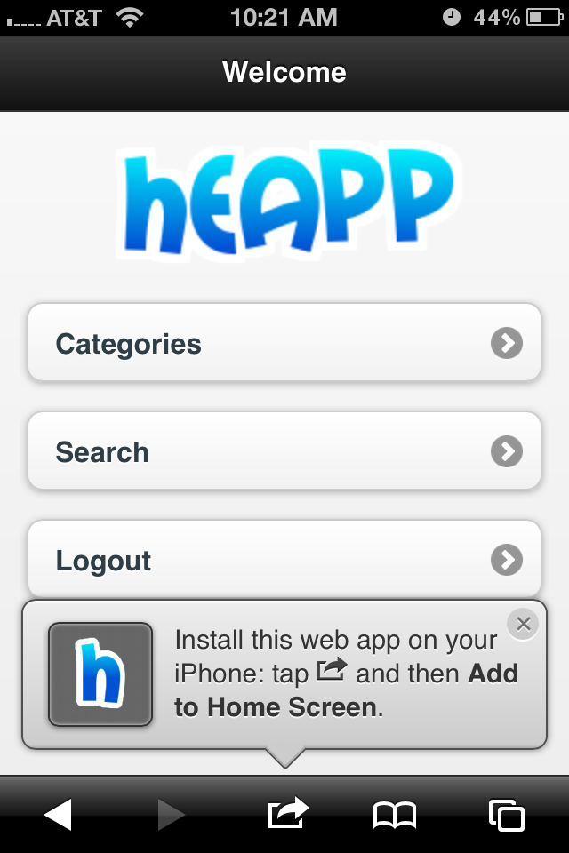
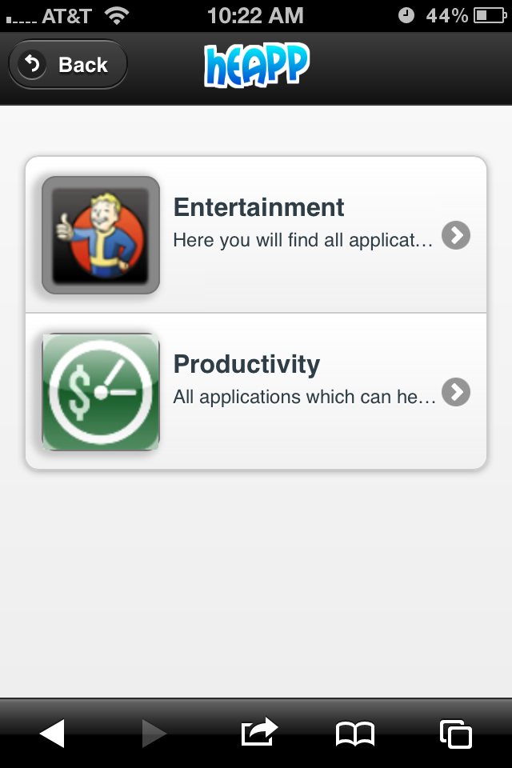
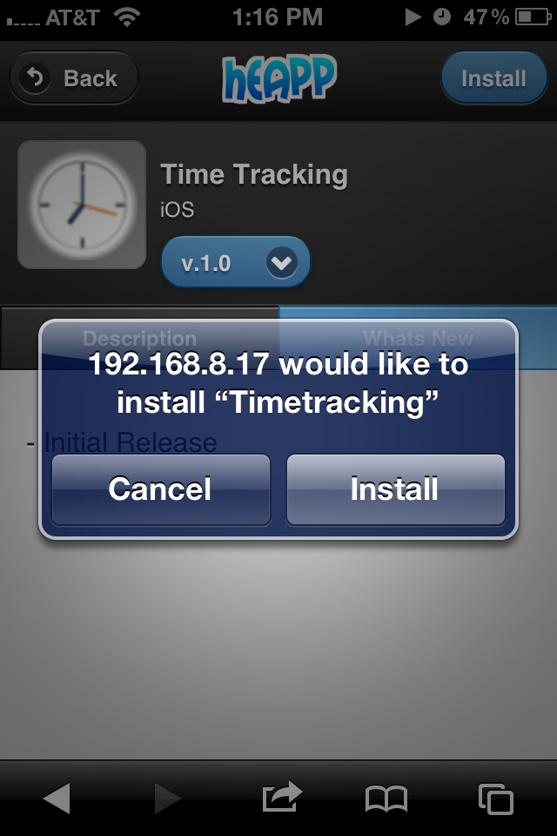
SPARC Mobile App Distribution
Notes:
A few screen shots
Project code name is heapp
We’re rebranding at the moment for the official launch and you can go to sparcedge.com for more information on the product, release dates as well as where to get it
You can see a very easy to use mobile interface for searching for an application and installing it

Slide 20
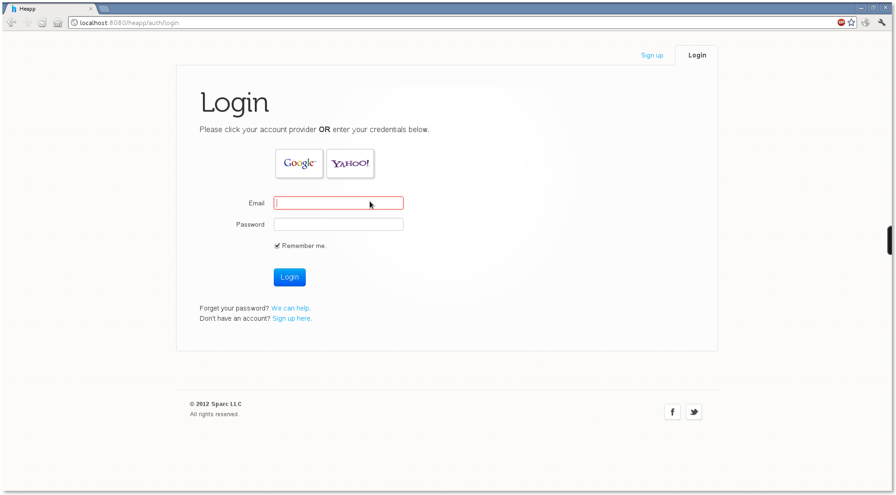
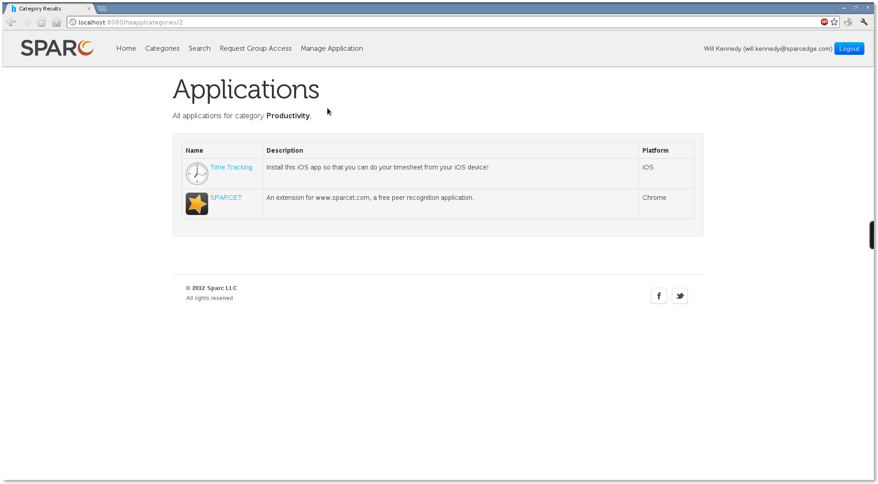
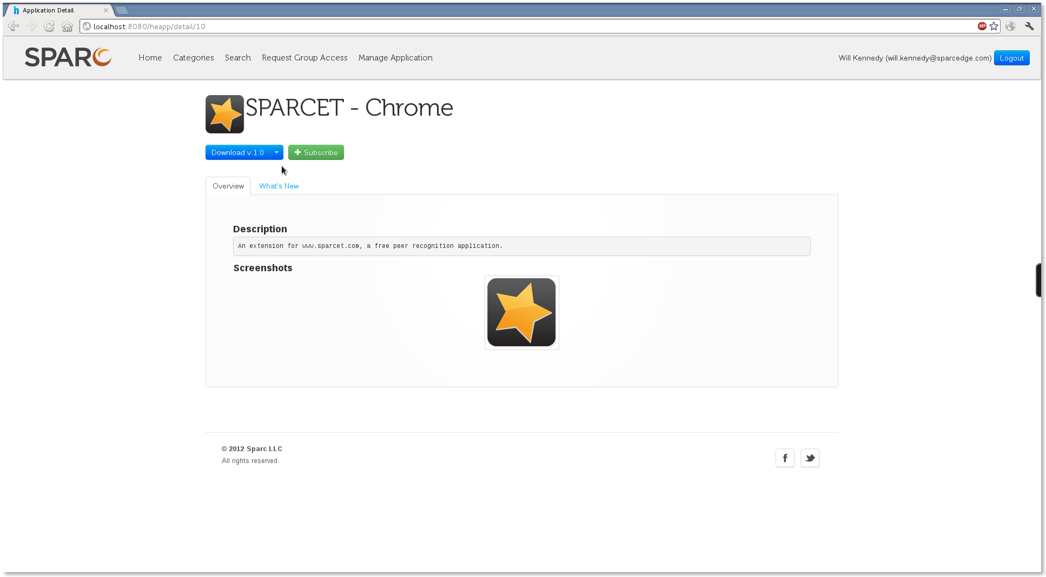
SPARC Mobile App Distribution
Notes:
Here are a few more screen shots showing the web presence
You can search, manage and administer your apps from here

Slide 21
Technology Stack
View Technologies
Spring MVC, ThymeLeaf, JQuery/JQuery Mobile
Persistence
Spring Transactions, HSQLDB / MySQL, QueryDSL, EclipseLink
Security
Spring Security, OpenID
Logging
Logback
Testing
JUnit, Mockito
All Open Source!
Notes:
As with SPARCIQ the entire product is built on an open source stack

Slide 22
Your Challenge!
Why Don’t We
Open Source
Our Entire Company?
Notes:
So I challenged you early on to open source everything you can
Gave you the promise of
an engaged, excited and more innovative workforce
understanding your business better
competitors becoming your collaborators
Gave you 5 easy steps to get there
Gave you some insight into why we at SPARC open source
And even gave you some concrete examples of things SPARC open sources
And so I’ll reiterate my challenge
And ask you to ask yourself, why don’t we open source our entire company?

Slide 23
Oh, and by the way…
This Entire Presentation Has Been Open Sourced!
https://github.com/sparcedge/
Notes:
Oh and btw…as I have said SPARC, is embraces the open source model
and in that spirit we have open sourced this entire presentation which you can find at the above link
It’s free to you to take and use as needed and improve as you want
I only ask that if you do please drop me a line and let me know…I’d love to hear from you

Slide 24
Thank You!
bob.williams@sparcedge.com
@_bobwilliams
tours@sparcedge.com
www.sparcedge.com
Notes:
Ok, I’ve taken up enough of your time and want to thank you for being a part of this
If you have questions I’ll be around, please come find me and we can chat
Thank you!

